Slide 1

Vocation Lessons
Helping Catholic Students
Remain Open to God’s Call
Published by Vianney Vocations

Slide 2
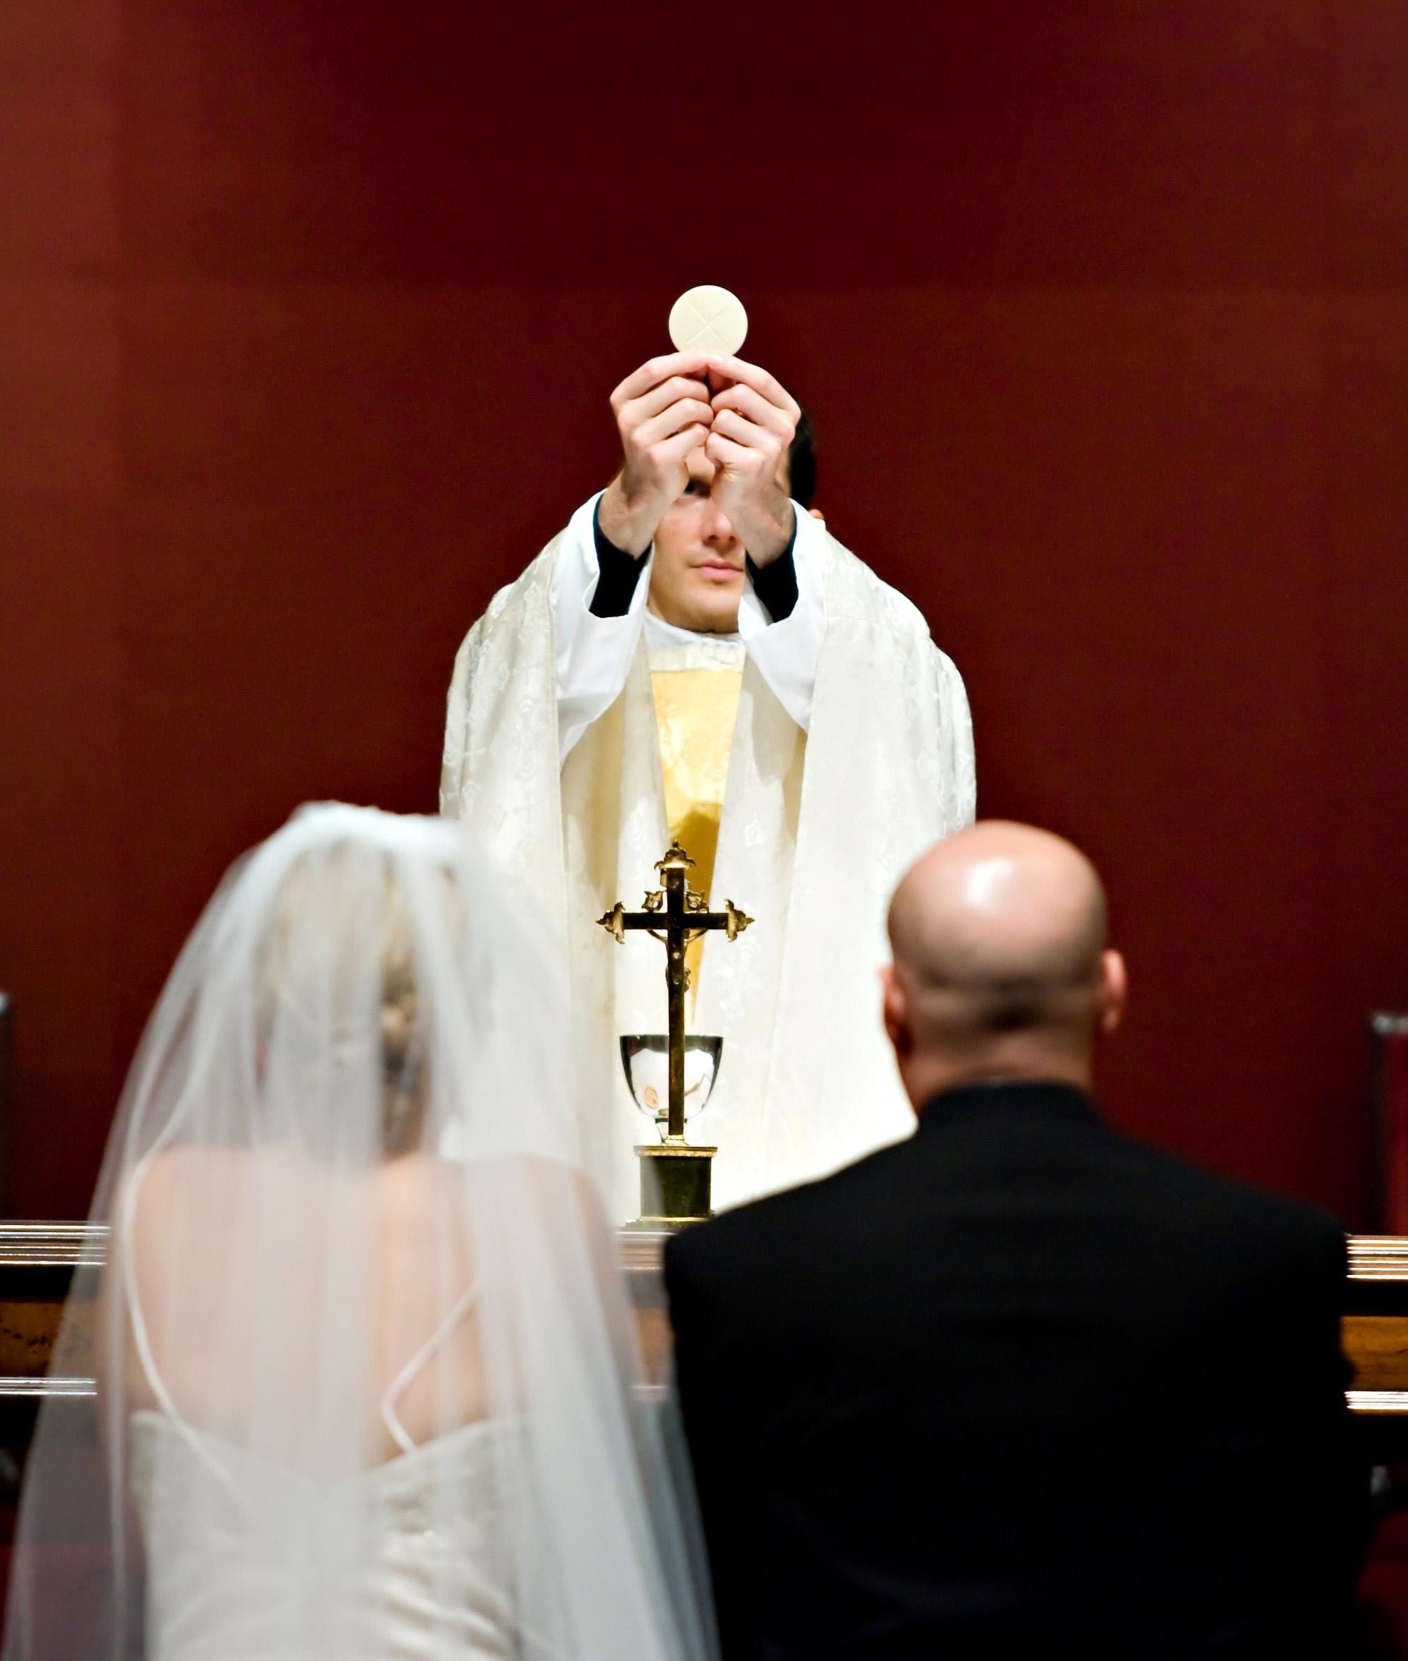

Vocation Lessons is a curriculum supplement for K-12 religion classes.
Its objective is to help students appreciate each vocation and remain open to God’s call.

Slide 3
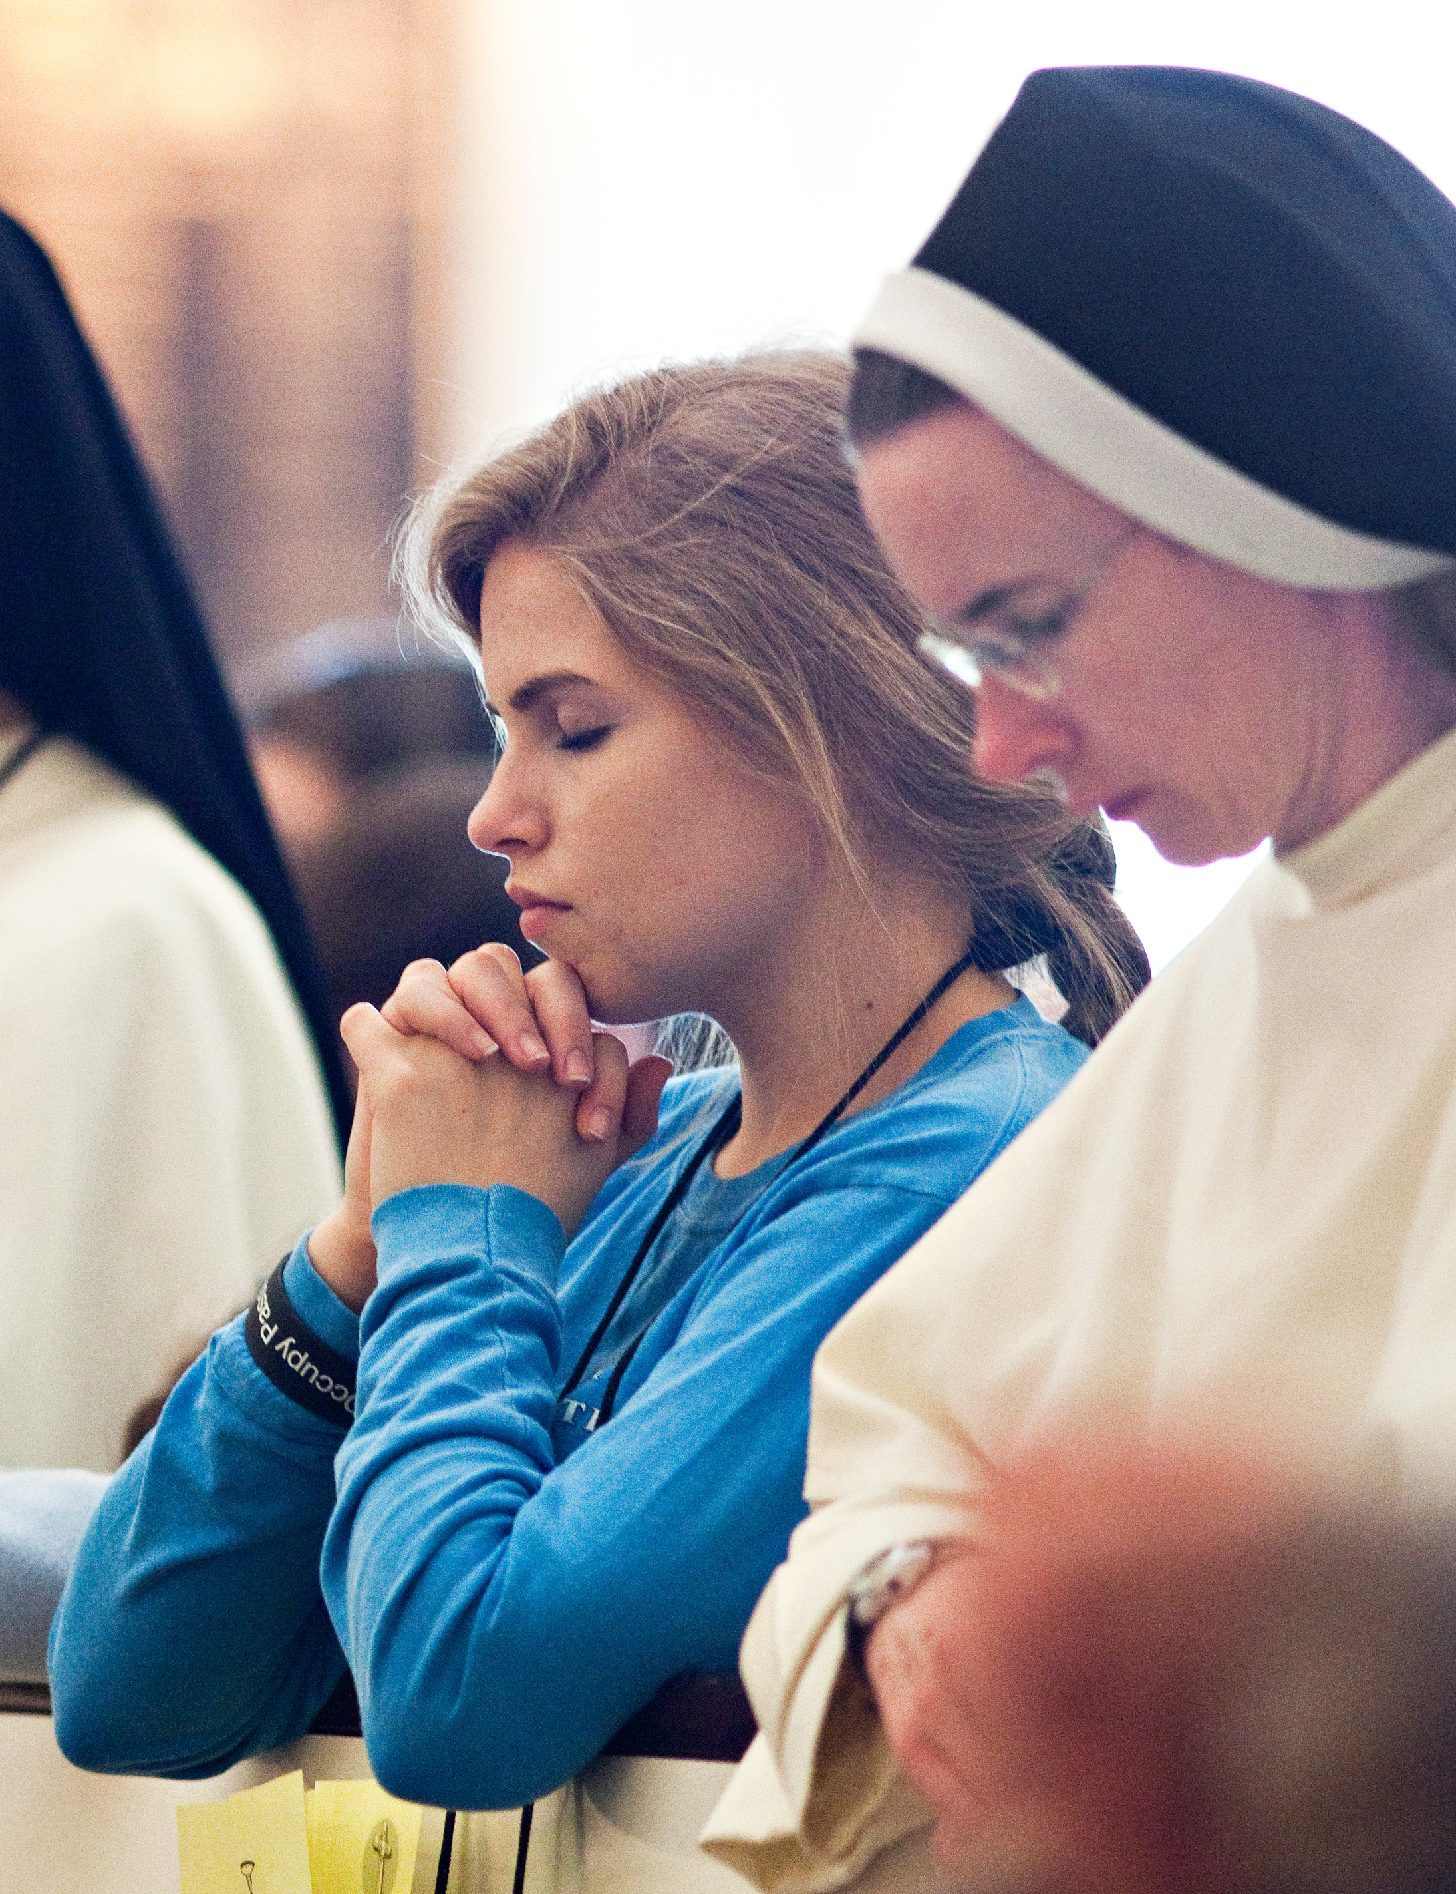
Our Topics Today
The need for vocations to priesthood, religious life, and holy marriage
The meaning of vocation
Why a vocations curriculum?
Format and features of Vocation Lessons
Sample lessons

Slide 4
Vocations in the U.S.
Catholic population continues to rise
The number of religious sisters has declined
The number of priests has declined
Number of seminarians same for 20 years
Sacramental marriage misunderstood
Diocese of XXXXXX: XXX,000 Catholics in over XXX parishes, with only XXX active diocesan priests.

Slide 5
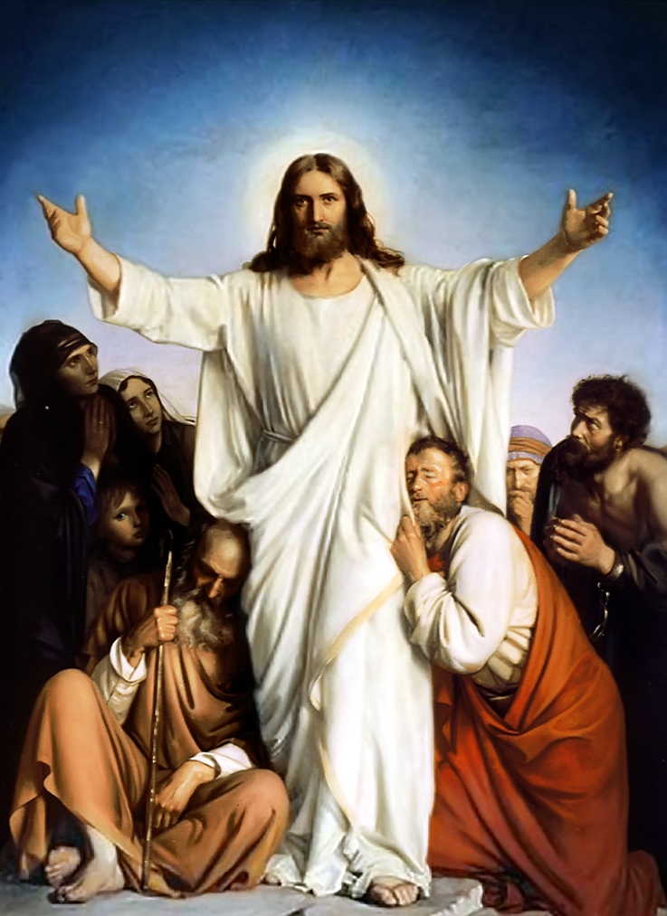
Key Concept:
Discipleship as Fundamental Identity

Slide 6

VOCATION:
How You Follow Jesus
~ Or ~
Your Primary Mission in Life

Slide 7
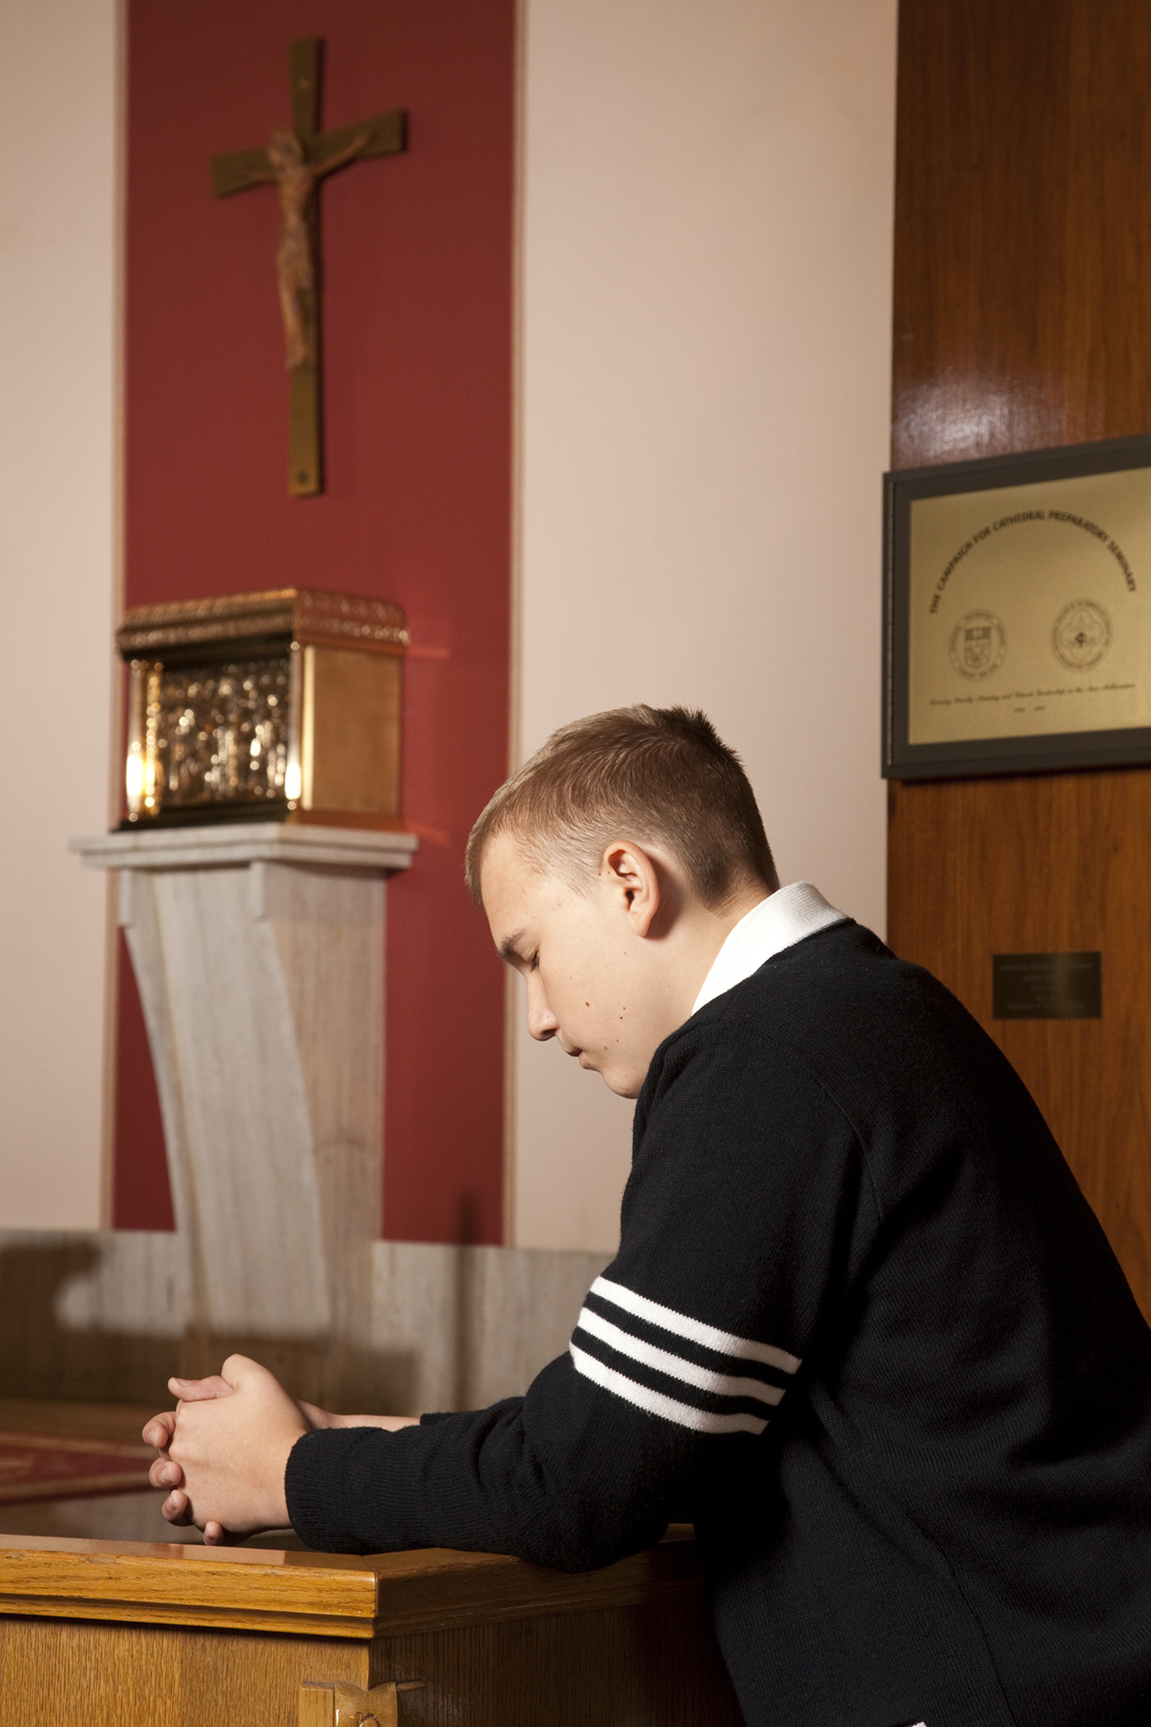
Key Concept:
Discernment Always Follows Discipleship

Slide 8
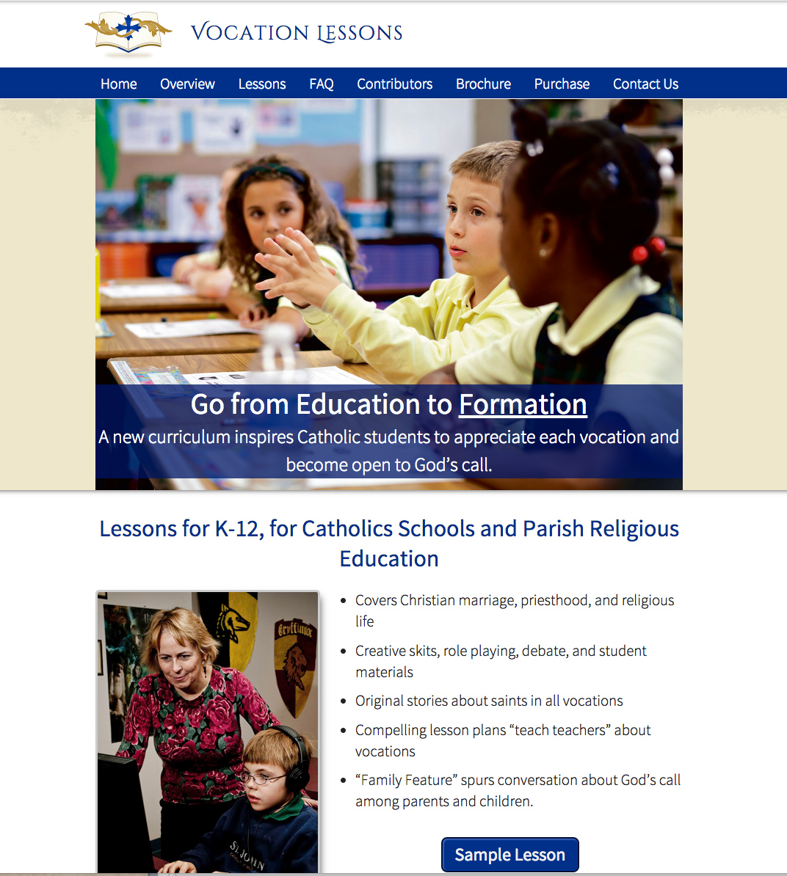
Vocation Lessons – Student Goals
Understand that holiness is the first vocation
Thoroughly understand each vocation
Have the tools to discern God’s call later in life
Be open to God’s will

Slide 9

Beyond Education
to
Formation

Slide 10
Goal:
Foster Appreciation & Respect for Each Vocation

Slide 11
Vocation Lessons – Structure
One unit per grade
Every grade has six elements:
  A lesson on Marriage
  A lesson on Priesthood
  A lesson on Religious Life
  A lesson on Discernment (or “God's Call”)
  Assessment (homework or test)
  Family Feature
Can be taught as a unit or stand-alone lessons

Slide 12
Vocation Lessons – Format
100% online at vocationlessons.com
Works on smart boards, tablets, and phones
Printable PDFs available for every lesson—a teacher version and student version

Slide 13
Vocation Lessons – Features
Lecture notes for teachers
Original stories
Student worksheets
Class games and activities
Visual art
Videos
Music
Prayer

Slide 14
Vocation Lessons - Takeaways
Discerning one’s vocation is a critical life skill for Catholic students.
Diocese of XXXXXXX access codes
  Teachers: [teacher_access_code]
  Students: [student_access_code]
National Vocation Awareness Week is November 1-7, 2015

